Slide 1



Team 007
An CP3402 – Assignments 2
#Team Members {
Anukul Sharma
Douglas Rosa
Masahito Takemura
Saimon Khadka }

Slide 2


OUR AGENDA ( )
Our Workflow
The Process Explained
Limitations
Alternative Approach
Demo

Slide 3

/* OUR WORKFLOW */
PLAN
>>>
DESIGN
DEVELOP
>>>
BUILD

Slide 4



// OUR WORKFLOW v2.0
PLAN
DESIGN
BUILD
Content Development & Content Creation
Content Integration & Site Build
Identify Goals
Staging
Strategic Planning
Site Structure Design & Content Strategy
Fine Tuning & Launch
Commit

Slide 5
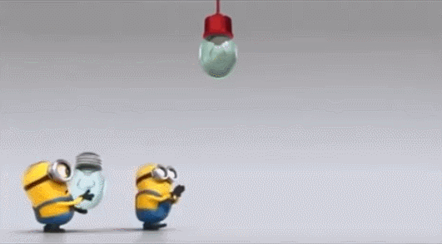
TEAM WORK_TheProcess ;
Small group allowed each member to work on specific tasks that complement but were not highly interdependent
Relied on good communication to make everyone aware of any breaking changes
Continuous commits allowed us to practice good version controlling of code and data

Slide 6

<!-- LIMITATIONS -->
Time Constraint
Limited Unit Testing
Required Lots of communication
Prone to merge conflicts with poor communication

Slide 7
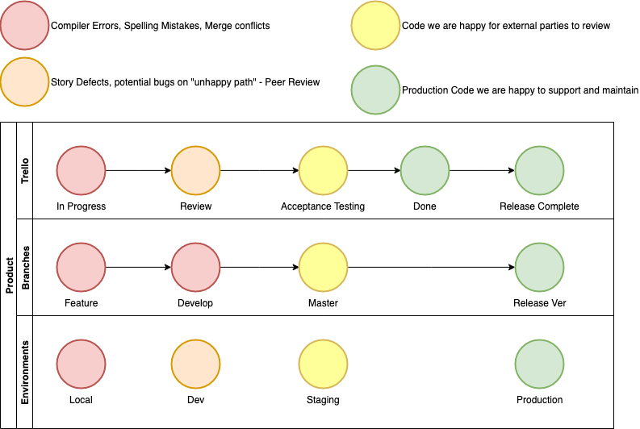
.ALTERNATIVE {workFLOW}

Slide 8

<? WHAT WE CREATED >
INPUTS
DEMO ()
{
IDEAS
CHOICE
INNOVATION
}
EFFORTS

Slide 9

< THE END />

